Slide 1
DOCUMENT READING SYSTEM FOR BLIND PEOPLE “READING EYE” 19-20-J 17

Slide 2

Project Proposal Presentation
CDAP
Sri Lanka Institute of Information Technology

Slide 3


Our Team
E.M.D.D. Ekanayake.
I.N. Kalansooriya.
P.S.N. Kularathne.
W.R.P. Fernando.
IT16102156
IT16176348
IT16165762
IT16079328
0777724874
it16102156@my.sliit.lk
0771537237
it16176348@my.sliit.lk
0772789541 it16165762@my.sliit.lk
0774577122
it16079328@my.sliit.lk

Slide 4
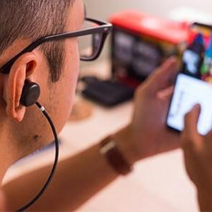
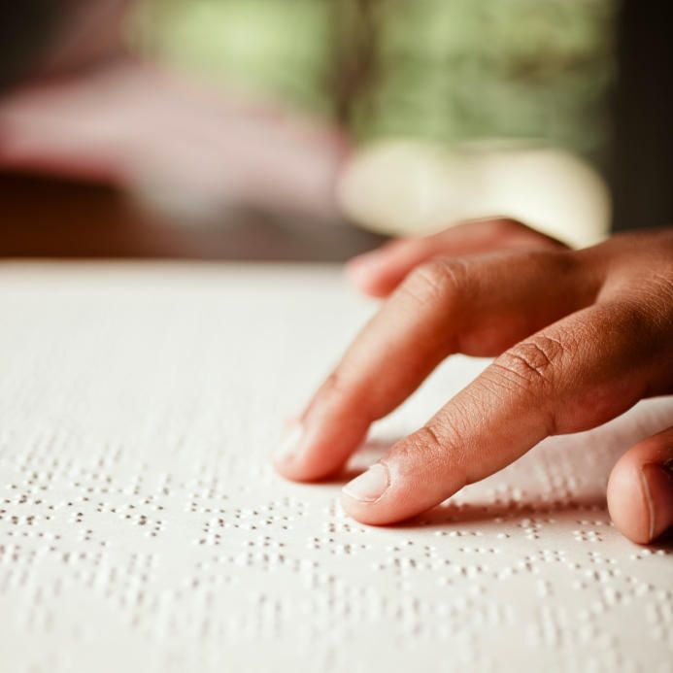
“READING EYE”
Reading is essential in context of education to
encompass the literacy to read and write for
individuals. Globally, it is estimated that
approximately 1.3 billion people live with some
form of vision impairment.
People who are vision impaired do not have easy access to print materials because most of the
materials must be written using Braille for them to read. Even if they could find the materials,
Reading is quite tedious process and mistakes can occur often because it is done by touching the
Braille letters. Not only that, Braille literacy is not high for every person. Many children and newly
blind adults struggle when learning Braille.
Although this leads to slow reading time as well,
especially when comparing with sighted readers.
Therefore to reduce the problems of reading
literacy of visually impaired people in the present and encompass that we propose
“Reading Eye” Document Reading System.

Slide 5
Contents
01
Literature Survey & Research Gap
02
Research Problem
03
Proposed Solution
04
> Main Objective
> Specific Objectives
Objectives
05
> System Architecture
> Work Breakdown
> Methodology / Tech Review
Project Plan
06
Individual Components

Slide 6
Literature Survey
Globally, it is estimated that approximately 1.3 billion people live with some form of
vision impairment.
There are Many mobile applications for visual impaired individuals in present.
Examples:
Schmoozer
Amazon Kindle
BARD Mobile
Capti Voice
KNFB Reader
Notes:
Edge Detection and Image Auto Capturing Graphical Content Identification Graphical Regions Identification Graphical Image Identification Mathematical Equation Identification Table Data Identification Implement Web Service Audio Assistance Functionalities

Slide 7
Research Gap
Every application missing one or more very important functionalities
Examples:
Able to identify images, equations, tables, charts other than texts.
Security when communication with cloud or servers.

Slide 8
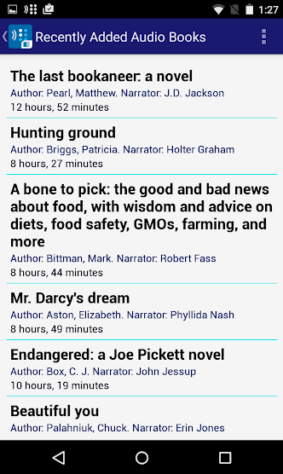
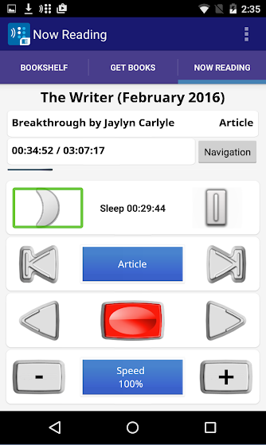
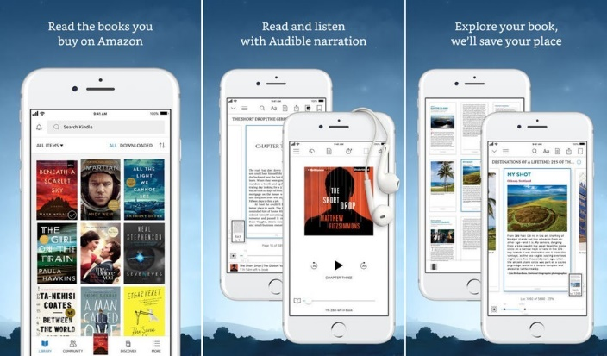
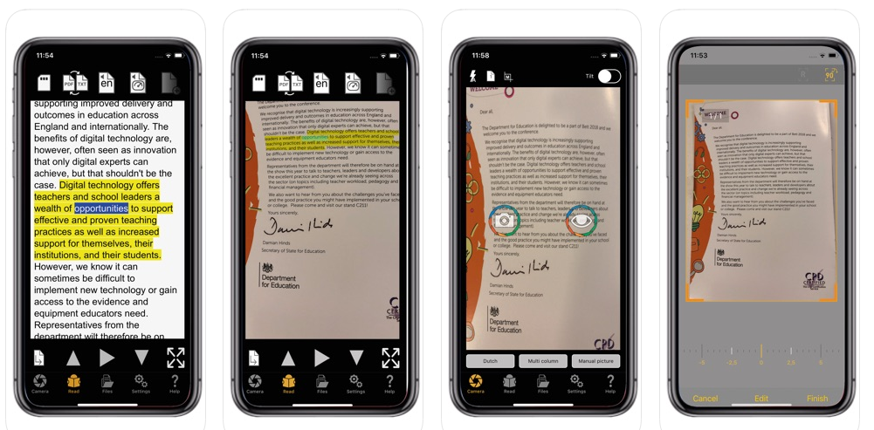
Existing applications
Amazon Kindle
BARD mobile app
KNFB reader

Slide 9

Systems
 | Amazon Kindle | BARD Mobile | Capti Voice | KNFB Reader | Schmoozer | Reading Eye (Proposed System)
Text Identification and Reading
Graphical Image /Pictures Identification and Reading | ❌ | ❌ | ❌ | ❌
Equations Identification and Reading | ❌ | ❌ | ❌ | ❌
Table content Identification and Reading | ❌ | ❌ | ❌ | ❌
Charts Identification and Reading | ❌ | ❌ | ❌ | ❌ | ❌
Voice output |  | ❌
Voice input (Voice as command inputs) | ❌ | ❌ | ❌ | ❌ | ❌
Cloud Storage | ❌ | ❌ | ❌ | ❌
Client-server communication data security | ❌ | ❌ | ❌ | ❌ | ❌
Cross Platform Mobile Application (Android/ IOS) |  |  | ❌ |  | ❌
Images’ size reduction for efficient communication | ❌ | ❌ | ❌ | ❌ | ❌
Features

Slide 10
Research Problem
Is reading an easier task for a sighted person like most of us take it for granted
but for a blind person?
Use of centuries old slow Braille code reading in this modern society.
Braille reading speed is comparatively slower.
Inaccessibility of Braille format of any book.
Though numerous tools and systems were introduced, those tools do not satisfy
the true needs of a blind person.
Most of visually impaired people can not afford the expensive devices that have introduced for them to read.
Most of modern systems only support text reading.

Slide 11
Proposed Solution
Hight Security
User Friendly
Using encryption algorithm.
Client-server secure connection.
Single voice command and start analyze.
Auto focus and capturing.
More Accuracy
Quick Response
Plan Risk Responses
Using deep learning and neural networks.
Light weighted data transmission.
Using high level technologies.
Best trained data sets.
All In One Application
Low Cost
Text, Images, Charts, etc. analyze on time.
More detailed output.
No maintaining cost.
Not any devices cost.

Slide 12
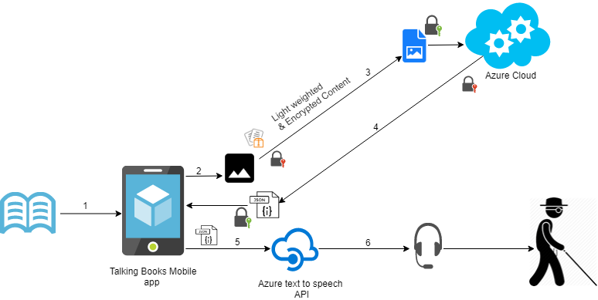
System Architecture

Slide 13
Main Objective
To improve visually impaired people reading capability as normally sighted people.
Implementation of a document reading system called “Reading-Eye”
to facilitate visually impaired people to read printed documents that are not
written using the braille system and help them to improve their reading
capability as normally sighted people.

Slide 14
Specific Objectives
Encourage and help visually impaired people to read independently by only
capturing the photographs of the documents without restricting his/her movements.
Enhance the security of the collected data, application, client-server communication and reduce the size of images for highly efficient communication.
Make documents more accessible for vision-impaired people to gain knowledge and
expose them to new areas of knowledge and at the same time allow the visually
impaired people to reach the same level of reading level as a normally sighted
person
Make the reading is an enjoyable experience for visually impaired people rather than a tedious,
unexciting one and provides the best user satisfaction and greater performance of the
generating audio system.

Slide 15
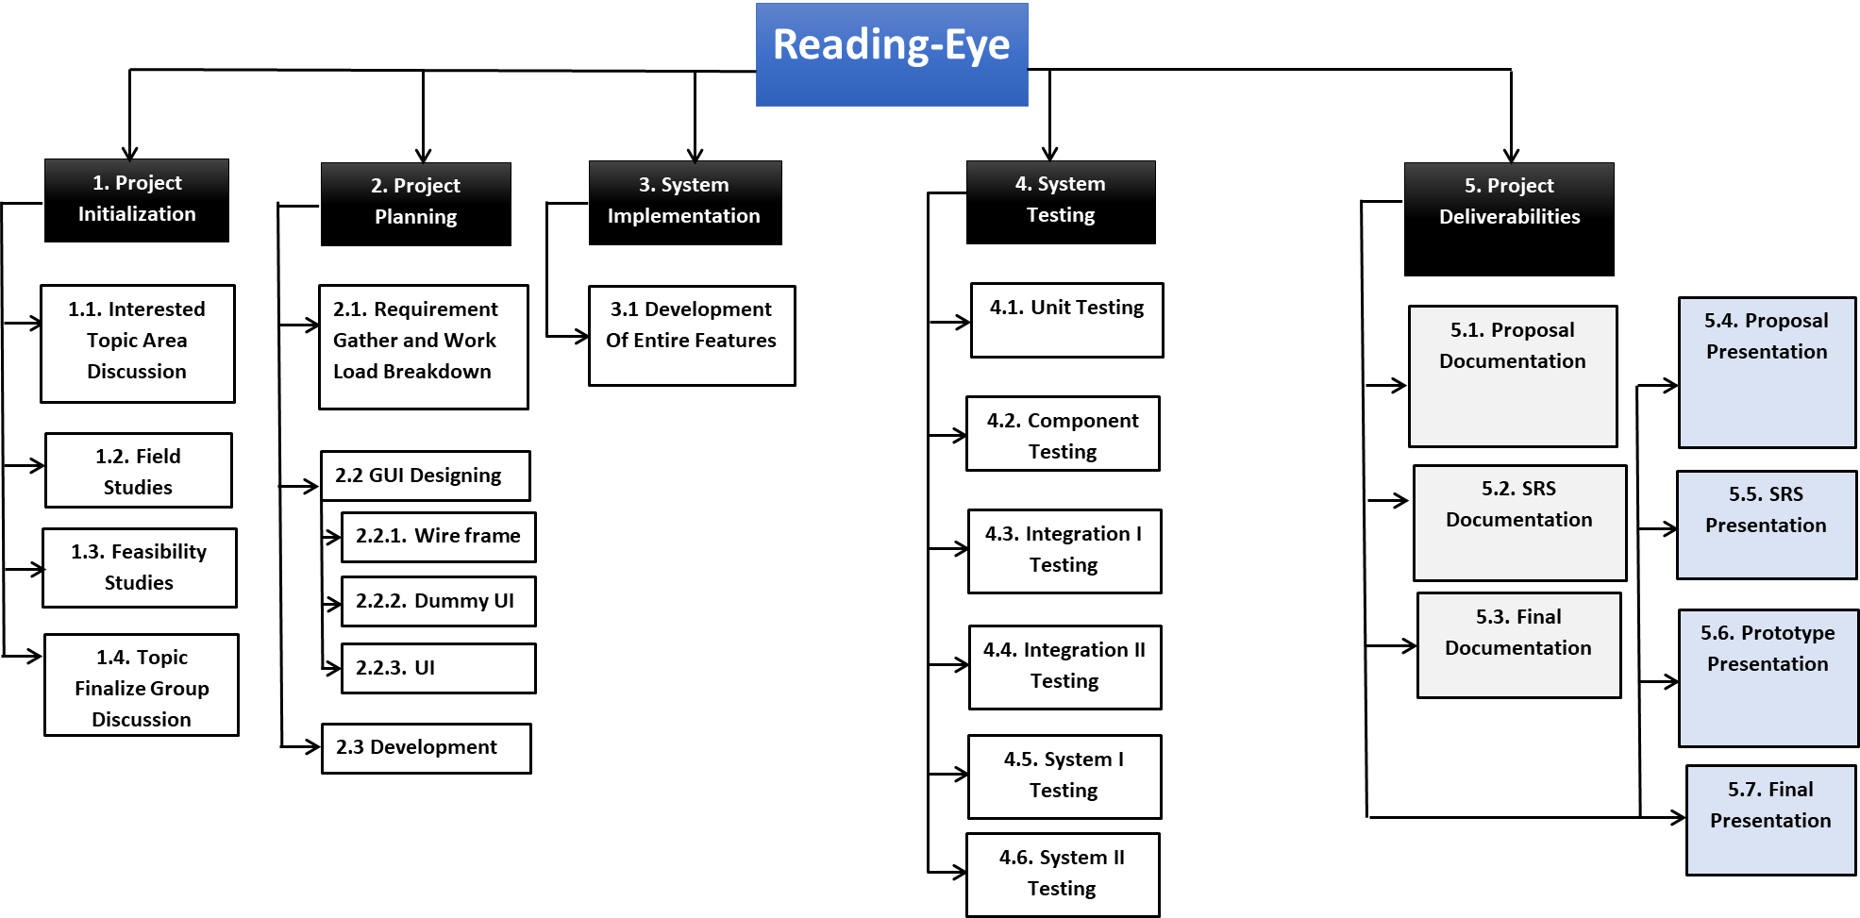
Work Breakdown Structure

Slide 16
Individual Components
Analyzing and Describing Text with Creation of the Mobile Application.
- By Dinuka Ekanayake.
Create an Algorithm to Encryption and Reduce the Size of the Images.
- By Ishan Kalansooriya.
Analyzing and Describing Charts and the Equations in the Documents.
- By Sasmitha Kularathne.
Analyzing and Describing Images and Tables in the Documents.
- By Rashinka Fernando.

Slide 17
Analyzing and Describing Text with the Creation of the Mobile Application
Develop a user-friendly cross-platform mobile application for vision-impaired people.
Analyze captured photos and auto-rotate the image in the actual direction where the captured image should be in the actual position.
Make the single command to start analyzing.
Make the option after analyzing the document auto play starts and the user able to listen to the document.
Identify text, images, charts, tables, and the equations uniquely and create another digital image for different identical matches.
In text - Identify language patterns and create a detailed description.
Generate a JSON file of that detailed description for the user to listening purpose.
Concatenate all JSON files and generates a single audio clip using open source API service for the user to listen.

Slide 18
Algorithm implementation for Encryption and to Reduce the Size of the Images
Create an algorithm to reduce the size of the images, remove noises and preprocesses to get meaningful information.
Create an encryption algorithm to make the assurance of the communication.
The encryption algorithm must include the following properties.
High efficiency
Resistant to brute force attacks
Use the Diffie-Hellman algorithm for the secure key exchange to make key exchange much more secure and reliable.
Use randomly generated 256-bit long secret key and embed it into the application to make key storage much more secure.
Enforce cloud policies to safeguard and handle the process according to the standards and best practices.

Slide 19
Analyzing and Describing Charts and the Equations in the Documents
Detect charts, equations in the uploaded digital photos of the document.
In charts - Identify the type of the charts as,
Line charts
Bar charts
Pie charts etc.
Represent the relevant data of the charts accordingly by using natural language processing and deep learning techniques.
In equations - Identify numbers, variables, and operators in the complex equations accordingly using neural networks and machine learning techniques.
Create a detailed description of the identified content of charts and equations.
Generate an audio file of that detailed description for the user to listening purpose.

Slide 20
Analyzing and Describing Images and the Tables in the Documents
Detect images, tables in the uploaded digital photos of the document.
In Images - Identify objects, people, places, actions and background regions in the image using deep learning techniques.
In tables - Identify columns and row data in tables accordingly and analyze the content.
Create a detailed description of the content that was identified for both images and tables.
Generate an audio file of that description for the user to listening purpose.

Slide 21






Technologies To Be Used
Machine Learning Techniques Frameworks
Keras, Python, OpenCV
TensorFlow will be used to create DL models.
Optical Character Recognition
Tesseract OCR Engine
Cloud Hosting Service
MS Azure cloud will be used for hosting and backend processing.
Text-to-Speech API
MS Azure service
Mobile App
React Native will be used for implementation of the cross-platform mobile application.

Slide 22
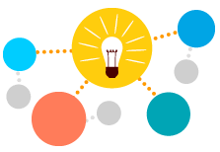
Why Chose That Technologies
Machine Learning Techniques using Python, OpenCV
Performance Matters!
Open Source
More functions for computer vision
Continuous updates
Large Community
Azure Cloud Services
Secure
Stable versions
Realtime updates
Other console features
Large community

Slide 23
Budget Plan For Developing
Description | Qty | Unit Cost (Rs.) (for 1 year) | Total Amount (Rs.)
Hosting charges (Azure cloud) | 1 | 76,000 | 76,000
Cost for devices (2 Smart phones for Testing not necessary) | 2 | 57,500 | 115,000
Traveling charges | 4 | 10,000 | 40,000
Communication charges | 4 | 10,000 | 10,000
Printing charges | - | 1,500 | 1,500
Stationary charges | 4 | 500 | 2,000
Internet Facility | 4 | 12,000 | 48,000
Other charges | 4 | 2000 | 8,000
Total Project Cost Estimate |  |  | 300,500
Description Quantity Unit Cost (Rs.) Total Amount (Rs.)
(for 1 year)
Hosting charges (Azure cloud) 1 76,000 76,000
Cost for devices (Smart phones for Testing) 1 115,000 115,000
Traveling charges 4 10,000 40,000
Communication charges 4 10,000 10,000
Printing charges - 2,500 2,500
Stationary charges 4 500 2,000
Internet Facility 4 12,000 48,000
Other charges 4 2000 8,000
Total Project Cost Estimate 301,500

Slide 24
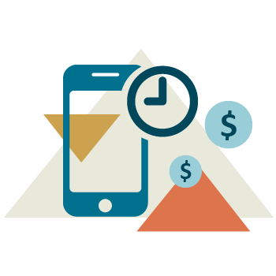
Commercial Value
No translation cost.
No language barrier.
Not needed any other physical devices.
No maintaining cost.
Any Time, Any way.
Saving Time.
Notes:
Not needed to translate document to braille
Using only mobile phone.

Slide 25
References
[1]"Braille Facts", Royalblind.org, 2019. [Online]. Available:
https://www.royalblind.org/national-braille-week/about-braille/braille-facts.
[Accessed: 07- Aug- 2019].
[2]"Braille", En.wikipedia.org, 2019. [Online]. Available:
https://en.wikipedia.org/wiki/Braille. [Accessed: 07- Aug- 2019].
[3]"The History of Braille [Your Braille Resource] - Braille Works", Braille Works,
2019. [Online]. Available: https://brailleworks.com/braille-resources/history-ofbraille/. [Accessed: 08- Aug- 2019].
[4] D. Radojichikj, "STUDENTS WITH VISUAL IMPAIRMENTS: BRAILLE
READING RATE", (IJCRSEE) International Journal of Cognitive Research in
Science, Engineering and Education, vol. 3, 1, 2015, 2015. [Accessed 8 August
2019].
[5]"Braille versions of textbooks help blind college students succeed - Marketplace",
Marketplace, 2019. [Online]. Available:
https://www.marketplace.org/2017/10/12/braille-versions-textbooks-help-blindcollege-students-succeed/. [Accessed: 09- Aug- 2019]

Slide 26

Discussion

Slide 27
Thank you..!

